Slide 1
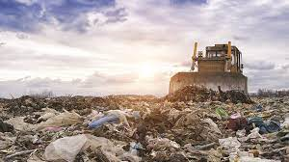
Year 5 Summer 2 In the Landfill
Curriculum Driver: DT and Science

Slide 2
Year 5 Summer 2 – In the Landfill Key Curriculum Driver: DT Other Curriculum Areas: Science and Art Rationale: In the Landfill will provide the children with opportunities to explore where our rubbish goes after we’ve put it in the bin. We will discover all about our effect on the planet and delve into what plastic pollution is. The children will have the opportunity to create their own treasures made from items that would normally be thrown away! By the end of this topic, most children will have: Use research and develop design criteria to inform the design of innovative, functional, appealing products that are fit for purpose.
Use research and develop design criteria to inform the design something that is aimed at particular individuals or groups.
Generate, develop, model and communicate ideas through discussions.
Create annotated sketches, prototypes, pattern pieces and computer-aided designs.
Select from and use a wider range of tools and equipment to perform practical tasks.
Select from and use a wider range of materials and components.
Use a variety of construction materials, textiles and ingredients.
Investigate and analyse a range of existing products.
Evaluate ideas and products against your own design criteria.
Consider the views of others to improve your work.
Understand how key events and individuals in design and technology have helped shape the world.
Understand the use of mechanical systems in what you have made. (E.g. cams, levers and linkages).
Understand how a variety of ingredients are grown, reared, caught and processed.
Understand what happens to our rubbish after we have thrown it away.
Discuss the impact of humans on our land and how it affects wildlife.
Children’s knowledge will be shown by: Non-chronological reports
Formal and informal letters to the government and the local community. Extended Writing: Non-chronological reports Formal letters to government Purposeful Outcome – To create ‘treasure’ out of rubbish. E.g. to use DT skills to create a purse from items that would be thrown away.

Slide 3
Year 5 Summer 2 - In the Landfill
Subject | Objective
DT | Through a variety of creative and practical activities, pupils should be taught the knowledge, understanding and skills needed to engage in an iterative process of designing and making. They should work in a range of relevant contexts [for example, the home, school, leisure, culture, enterprise, industry and the wider environment]. When designing and making, pupils should be taught to: Design use research and develop design criteria to inform the design of innovative, functional, appealing products that are fit for purpose, aimed at particular individuals or groups generate, develop, model and communicate their ideas through discussion, annotated sketches, cross-sectional and exploded diagrams, prototypes, pattern pieces and computer-aided design. Make select from and use a wider range of tools and equipment to perform practical tasks [for example, cutting, shaping, joining and finishing], accurately select from and use a wider range of materials and components, including construction materials, textiles and ingredients, according to their functional properties and aesthetic qualities. Evaluate investigate and analyse a range of existing products evaluate their ideas and products against their own design criteria and consider the views of others to improve their work understand how key events and individuals in design and technology have helped shape the world.

Slide 4
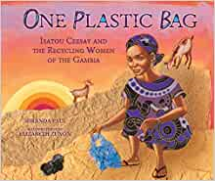
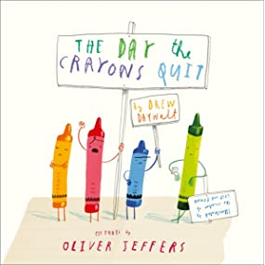
Topic Overview
Topic Hook
Now Press Play
Title: In the Landfill
Curriculum Driver: DT and Science
Topic Outcome:
To create a purse / wallet out of materials that would otherwise by thrown away.
Coverage (Main Focus)
Hook lesson- Lesson hook week (scientific experiments to understand our footprint on the world)
Science - observe how organic and inorganic materials decompose (observation and written experiment over time).
Science - Start a composting project. Composting is one way to reuse organic material that may otherwise end up in a landfill.
Art - make your own paper. One of the best ways to understand how recycling works is to do it yourself!
Calculate your impact - We all want to feel like we’re contributing to something bigger than ourselves and that we’re making a difference. If we reduce our consumption, it’s helpful to know what kind of impact it can make. Here are some questions and ideas to consider:
Calculate how much trash they generate in a day, week, month, and year.
Calculate how much trash their family, the school, their city or town, and their state generates per year. What are some ways they could reduce their CO2 emissions? Calculate how much it would reduce their emissions if their family used public transportation to go to school and work, used energy-efficient lightbulbs in their house, switched to a vegetarian or vegan diet, etc. If they reduced their CO2 emissions by 1/3, how much would CO2 would they produce? How much CO2 would they save?
Non-chronological reports about the impact of our carbon footprint.
Informal letters to an animal that has been affected by our plastic pollution
Formal letters to the government and our local MP / community about being more conscious of our footprint.
Free Writing Stimulus
Free write- writing to the government / local authority or community about ensuring we are recycling.
Extended Writing Genres and Activities
Extended writing- letter campaigning for less landfill and more recycling / less use of single use plastics.
Trips and Experiences
Walking around the local community and litter picking
DT to create a purse /wallet made of rubbish.
Other subject Coverage
Science– planning different types of scientific enquiries to answer questions, including recognising and controlling variables where necessary
taking measurements, using a range of scientific equipment, with increasing accuracy and precision, taking repeat readings when appropriate
recording data and results of increasing complexity using scientific diagrams and labels, classification keys, tables, scatter graphs, bar and line graphs
using test results to make predictions to set up further comparative and fair tests
reporting and presenting findings from enquiries, including conclusions, causal relationships and explanations of and a degree of trust in results, in oral and written forms such as displays and other presentations
identifying scientific evidence that has been used to support or refute ideas or arguments.
Art – Art skills linked to DT.
Linked Texts

