Slide 1
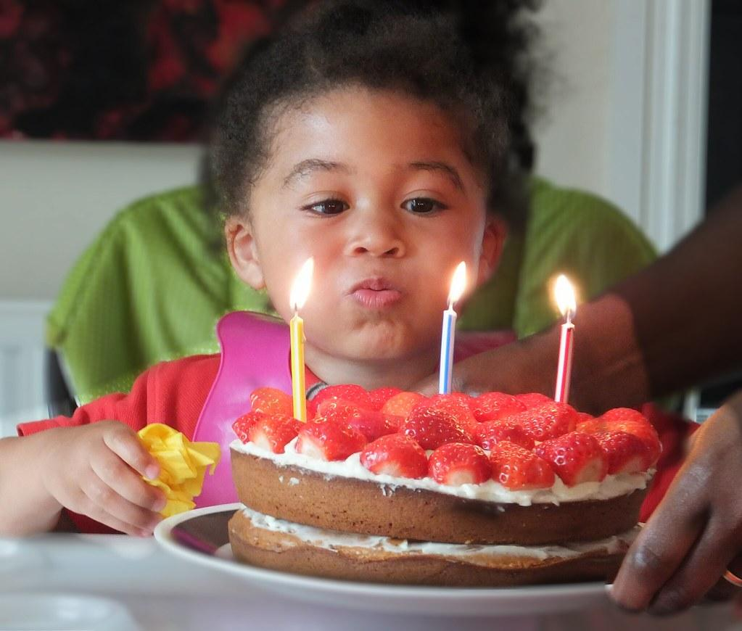
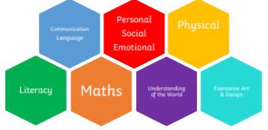
Nursery Autumn 1 I am 3.

Slide 2
Nursery
Autumn 1 - I am 3. Invitation to Play:
Rationale: By the end of this topic, most children will: Children’s knowledge will be shown by:
Purposeful Outcome – Added by class teachers after completeing topic web.

Slide 3
Nursery
I am 3.
AOL | Objective | Key vocabulary
PSED | Develop their sense of responsibility and membership of a community. Show more confidence in new social situations. Select and use activities and resources, with help when needed. This helps them to achieve a goal they have chosen, or one which is suggested to them Become more outgoing with unfamiliar people, in the safe context of their setting. | I feel… I can… Please help me to… My name is...
CL | Joins in with repeated refrains and anticipates key events and phrases in rhymes and stories Enjoy listening to longer stories and can remember much of what happens. Uses talk to explain what is happening and anticipate what might happen next | First, then, after I am...
PD | Continue to develop their movement, balancing, riding (scooters, trikes and bikes) and ball skills. Go up steps and stairs, or climb up apparatus, using alternate feet. • Skip, hop, stand on one leg and hold a pose for a game like musical statues. Manipulates a range of tools and equipment in one hand, tools include paintbrushes, scissors, hairbrushes, toothbrush, scarves or ribbons | Fast, slow, quickly, carefully. Safely.
Literacy | Makes up stories, play scenarios, and drawings in response to experiences, such as outings Sometimes gives meaning to their drawings and paintings Ascribes meanings to signs, symbols and words that they see in different places, including those they make themselves | I have… I can… I like....
Maths | Counting May enjoy counting verbally as far as they can go Cardinality Subitises one, two and three objects (without counting) | 1,2,3… Tens frame
UW | Begin to make sense of their own life-story and family history. Explore and talk about different forces they can feel. Talk about the differences between materials and changes they notice. | Family Mummy, Daddy, Granma, Grandad, Sister, brother, baby Happy, sad, frustrated, cross, excited, giddy
EAD | Take part in simple pretend play, using an object to represent something else even though they are not similar. Listen with increased attention to sounds | T:anguage linked to key texts - The Three Little pigs. The Three Billygoats. Kippers Birthday.
Key Lines of Enquiry: Throughout this topic the children will begin to look at their own family history and key events in their lives so far. They will share photographs of their 3rd birthday and use stories relating to the number 3 to develop their language and number skills.

Slide 4
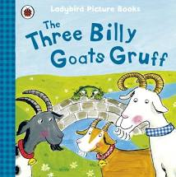
Topic Overview
Topic Hook
Hosting a birthday party.
I am 3
Topic Outcome
PSED
Over this half term children will become more familiar with the Nursery setting and will show confidence when selecting their own resources and tasks.
Through our Nursery helper tasks they will take pride in being part of our EYFS community.
CLL - The children will be invited to bring in photos of their third birthday to share with the group. This will allow staff to look at their speech and language skills.
Via a love of books the children will begin to join in with repeated refrains in books and use role-play to retell familiar stories.
PD - Children will use party games such as musical statues to stand on one leg and hold a pose. They will be introduced to Squiggle Whilst You Wiggle to begin controlling a range of one handed tools such as ribbons and paintbrushes.
Trike day! To end our topic on the number 3 we will be having a bike and trike day!
UW -
They will learn about their own family history and begin to sequence families by size and name.
Using the stories The Three Little Pigs and The Billy Goats Gruff, children will begin to explore forces and the differences between materials.
Lit - children will make birthday cards and recipes in the dough area when hosting their own party.
They will use the book of the week to learn new vocabulary and to act out familiar stories in role play.
M - Using the topic of 3 the children will begin to recognise groups of 3 objects without counting and will say number names in order. We will extend this to looking at shapes that have 3 sides and objects in the real world.
EAD - Children will take part in pretend play in out ‘Three little pigs building sites’ role play area. This will help them develop their love of stories. In our creative area the children will explore different materials and medium to make birthday gifts for each other. Exploring colour mixing using paint and giving meaning to their painting will be lots of fun.
Linked texts

