Slide 1
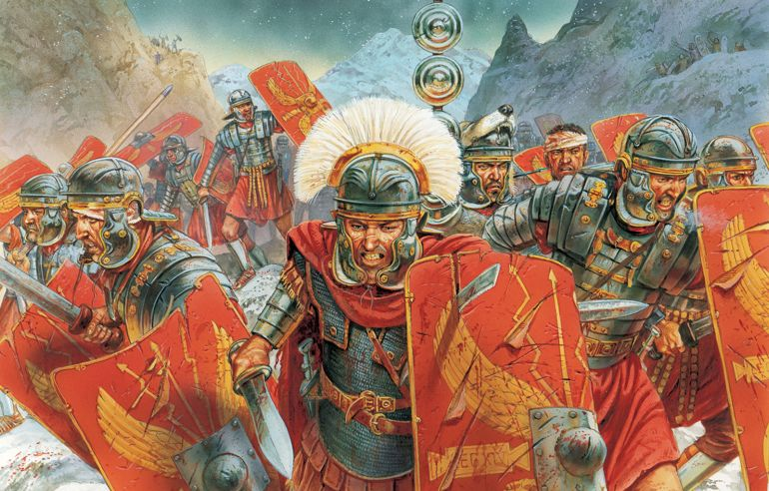
Year 4 Summer 1 In the Colosseum Curriculum Driver: History

Slide 2
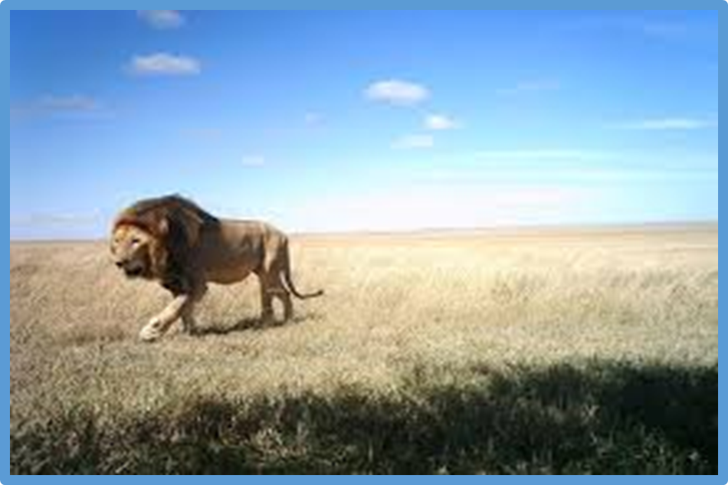
Year 4 Spring 2- In the Colosseum Key Curriculum Driver: History Other Curriculum Areas: Rationale: The ‘In Rome’ topic will allow children to have the opportunity to explore the history of Rome, the chronology in relation to other periods of time and to build an overview of the world around them. By the end of this topic, most children will have: The ability to think independently and raise questions about working historically and the knowledge and skills that it brings. • High levels of originality, imagination or innovation in the application of skills. • The ability to undertake practical work in a variety of contexts, including fieldwork. • A passion for History and its application in past, present and future technologies.
• The ability to think critically about history and communicate ideas very confidently in styles appropriate to a range of audiences.
• The ability to think, reflect, debate, discuss and evaluate the past, formulating and refining questions and lines of enquiry. Children’s knowledge will be shown by: Extended Writing: Writing a job application to become a legionnaire.
Writing a diary entry from the point of view of a Roman child.
Writing as an estate agent to persuade people to buy a Roman house.
Purposeful Outcome – Children to create a leaflet about the life of a Roman.

Slide 3
Subject | Milestone
History | • Use evidence to ask questions and find answers to questions about the past. • Suggest suitable sources of evidence for historical enquiries. • Use more than one source of evidence for historical enquiry in order to gain a more accurate understanding of history. • Describe different accounts of a historical event, explaining some of the reasons why the accounts may differ. • Suggest causes and consequences of some of the main events and changes in history. Give a broad overview of life in Britain from ancient until medieval times. Give a broad overview of life in Britain from ancient until medieval times. • Compare some of the times studied with those of other areas of interest around the world. • Describe the social, ethnic, cultural or religious diversity of past society. • Describe the characteristic features of the past, including ideas, beliefs, attitudes and experiences of men, women and children. Place events, artefacts and historical figures on a timeline using dates. • Understand the concept of change over time, representing this, along with evidence, on a timeline. • Use dates and terms to describe events. • Use appropriate historical vocabulary to communicate, including: • dates • time period • era • change • chronology. • Use literacy, numeracy and computing skills to a good standard in order to communicate information about the past.

Slide 4
Topic Overview
Hook
Clay making of Roman pottery for a banquet.
Title: In Rome
Curriculum Driver: History
Topic Outcome
Children create a presentation on life as a Roman soldier.
Science Coverage (Main Focus)
List activities
Lesson 1: Hook lesson- making pottery with clay for Roman banquet.
Lesson 2: Geograpical position of where the Roman Empire took over.
Lesson 3: What did the Romans invent that we still use today?
Lesson 4 and 5 Comparison of school in the Roman times and school in the modern day. (Flap out book - 3 sections, now, roman and similarities and differences)
Lesson 4: What did the Romans invent that we still use today? DT lesson- Design Roman Chariot to design, make and evaluate.
Lesson 5+6- Make Roman chariot- wheels and axels then evaluate design.
Lesson 7- Music lesson- Roman music- create their own signal for in the Army- look at Roman Army- look at tempo and using silence for dramatic effect. Instruments and body
Lesson 8- Roman numerals/ telling time lesson
Lesson 9: Roman housing- Compare how it is different to modern day life and also to one other period of time. Art lesson- Roman Mosaics
Lesson 10- Roman timeline of events- Julius caesar, Boudicca, fall of rome.
Lesson 11- Romulus and Remus and Roman Beliefs.
Lesson 12- Timeline of events
Free Writing Stimulus
Diary Entry from the point of view of a Roman child. What was it like? Did they enjoy it in Rome?
Extended Writing Genres and Activities
Produce a newspaper / newsletter / leaflet to present findings.
News report / radio report to practise oracy skills.
Diary entry
Job applications
Trips and Experiences
Clay experience of making own pottery.
History museum in Leeds next half term to consolidate knowledge?
Other subject Coverage:
Art and DT- Clay making
Linked Texts:
The Thieves of Ostia- Caroline Lawrence
What Would the Romans do?
Romans on a Rampage- Jeremy Strong
Rotten Romans- Horrible histories

