Slide 1
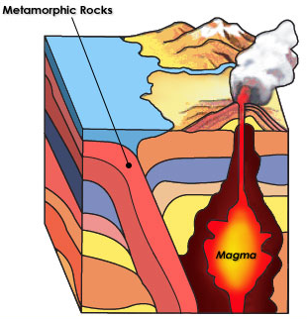
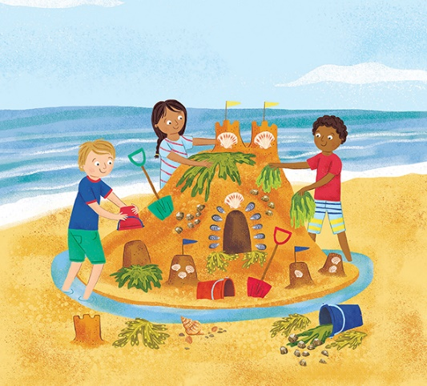
Year 3 Summer 1 On the cliff top Curriculum Driver: Science – rocks and soil Geography

Slide 2
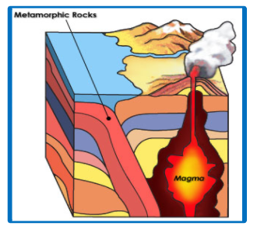
Year 3 Summer 1 – On the cliff top Key Curriculum Driver: Science Other Curriculum Areas: Geography Rationale: On The Farm will provide the opportunity for children to explore rocks and soils and the different terrains of beach environments. Understand why they are different and how they are formed. Look into the history of beaches in the UK and how they have changed over time. Investigate a range of different materials found on the beach and how they are formed. Focus on the geography of the beach and how beaches differ from one another. We will also take a trip to a beach nearby and explore the sand, rocks and other areas of the beach. By the end of this topic, most children will have: The ability to think independently and raise questions about working scientifically and the knowledge and skills that it brings. • Have confidence and competence in a full range of practical skills, taking the initiative in, for example, planning and carrying out scientific investigations. • Excellent scientific knowledge and understanding which is demonstrated in written and verbal explanations, solving challenging problems and reporting scientific findings. • High levels of originality, imagination or innovation in the application of skills. • A passion for science and its application in past, present and future technologies. Design with purpose by identifying opportunities to design. • Make products by working efficiently (such as by carefully selecting materials). • Refine work and techniques as work progresses, continually evaluating the product design. • Improve upon existing designs, giving reasons for choices.
Children’s knowledge will be shown by: Extended Writing:
English – Write a holiday travel brochure about a famous beach. Write a postcard from your trip to the seaside. Fact file – What are rocks? How are they formed? What are the different kind of rocks? Beach day advert. Write a recount from trip to the seaside.

Slide 3
Year 3 Summer 1- At The Seaside Chris Quigley Milestones Covered
Subject | Milestone
Science | • Ask relevant questions. • Set up simple, practical enquiries and comparative and fair tests. • Make accurate measurements using standard units, using a range of equipment, e.g. thermometers and data loggers. • Gather, record, classify and present data in a variety of ways to help in answering questions. • Record findings using simple scientific language, drawings, labelled diagrams, bar charts and tables. • Report on findings from enquiries, including oral and written explanations, displays or presentations of results and conclusions. • Use results to draw simple conclusions and suggest improvements, new questions and predictions for setting up further tests. • Identify differences, similarities or changes related to simple, scientific ideas and processes. • Use straightforward, scientific evidence to answer questions or to support their findings. Identify and describe the functions of different parts of flowering plants: roots, stem, leaves and flowers. • Explore the requirements of plants for life and growth (air, light, water, nutrients from soil, and room to grow) and how they vary from plant to plant. • Investigate the way in which water is transported within plants. • Explore the role of flowers in the life cycle of flowering plants, including pollination, seed formation and seed dispersal.
Geography | • Use fieldwork to observe and record the human and physical features in the local area using a range of methods including sketch maps, plans and graphs and digital technologies. • Use maps, atlases, globes and digital/computer mapping to locate countries and describe features. • Use a range of resources to identify the key physical and human features of a location. An excellent knowledge of where places are and what they are like. • An excellent understanding of the ways in which places are interdependent and interconnected and how much human and physical environments are interrelated. • An extensive base of geographical knowledge and vocabulary.

Slide 4
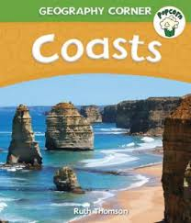
Topic Overview
Topic Outcome
To understand the geographical elements of a beach and use the vocabulary. Carry out science experiments to investigate.
Topic Hook
School trip to the beach in Filey.
Title: On the clifftop.
Curriculum Driver: Science and Geography
Science Coverage
Begin topic with ‘beach on the playground’ – use sand and a variety of rocks and shells to investigate what you might find on a beach. Use a magnifying glass to look closely at the sand and how different it looks up close. Investigate different shells and how they are formed. Where do they come from? Why are they found on the beach and not on the grass?
Investigate different types of rocks.. What are rocks? Where can they be found? Look at the geography of where rocks are found and why they formed there. Investigate different beaches and where different types of rocks are found.
Investigate erosion. What is this? Why does this happen? Where does this happen? Investigate different beaches where this happens.
Investigate volcanoes. What happens when they erupt? Look at the different types of rocks that are formed there. Eg igneous, metamorphic and sedimentary.
Geography – look at different beach locations. Look at maps of our country and the world. Where are beaches found? Are they found in the middle of the country? Are there beaches in leeds? Why not?
Free writing stimulus
Holiday brochure about the beach.
Postcards from the seaside. Beach day advert.
Extended Writing Genres and Activities
Information fact file about different types of rocks.
Non chronological report - How do volcanoes happen?
Trips and Experiences
Visit to Filey beach.
Other subject Coverage
Art – Sketch different shells. What can you see? William Turner - Look at artist work and create own version.
DT- Can you create your own paper mache shell? What materials do we need to create this? What foods can you eat from the beach? What about seaweed?
Music – ukuleles every Tuesday
Linked Texts

