Slide 1
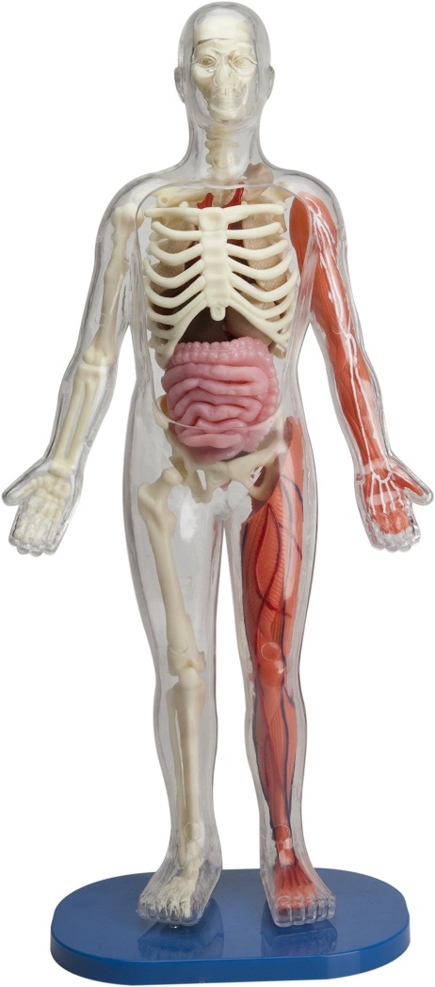
Year 3 Autumn 2 Inside the Human Body Curriculum Driver: Science PSHCE

Slide 2
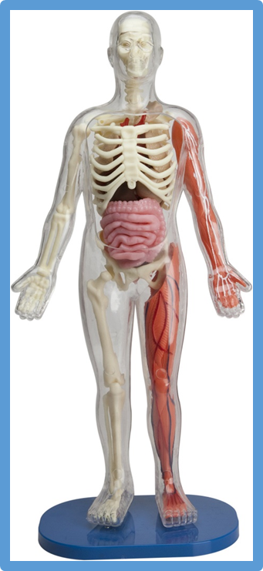
Year 3 Autumn 2 - Inside the Human Body Key Curriculum Driver: Science Other Curriculum Areas: PSHE Rationale: Inside the human body will provide the opportunity for children to explore nutrition, the transportation of water and nutrients in the body, and the muscle and skeleton system of humans and animals. In addition, children will explore the human digestive system, human teeth and circulatory system and compare them to other living things as stated in the National Curriculum. By the end of this topic, most children will have: The ability to think independently and raise questions about working scientifically and the knowledge and skills that it brings. • Have confidence and competence in a full range of practical skills, taking the initiative in, for example, planning and carrying out scientific investigations. • Excellent scientific knowledge and understanding which is demonstrated in written and verbal explanations, solving challenging problems and reporting scientific findings. • High levels of originality, imagination or innovation in the application of skills. • A passion for science and its application in past, present and future technologies. Children’s knowledge will be shown by: Extended Writing: A persuasive text Non Chronological Report
Information leaflets Poetry Purposeful Outcome – Produce an information leaflet about how the heart works on Google classroom.

Slide 3
Year 3 Autumn 2 – Inside the Human Body Chris Quigley Milestones Covered
Subject | Milestone
Science | • Ask relevant questions. • Set up simple, practical enquiries and comparative and fair tests. • Make accurate measurements using standard units, using a range of equipment, e.g. thermometers and data loggers. • Gather, record, classify and present data in a variety of ways to help in answering questions. • Record findings using simple scientific language, drawings, labelled diagrams, bar charts and tables. • Report on findings from enquiries, including oral and written explanations, displays or presentations of results and conclusions. • Use results to draw simple conclusions and suggest improvements, new questions and predictions for setting up further tests. • Identify differences, similarities or changes related to simple, scientific ideas and processes. • Use straightforward, scientific evidence to answer questions or to support their findings. • Identify the different types of teeth in humans and their simple functions. • Recognise that vibrations from sounds travel through a medium to the ear.
PSHE | Understand what makes a healthy lifestyle.

Slide 4
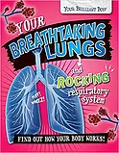
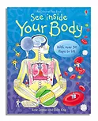
Topic Overview
Topic Hook
Interactive workshop on Learning all about how the teeth work.
Title: Inside the Body
Curriculum Driver: Science
Topic Outcome
To understand about healthy lifestyles and your insides.
_____ Coverage (Main Focus)
Begin topic with a visitor from Thackray museum (if available) if not teacher will run workshop showing children how the different teeth work using interactive resources.
Science - Understand what the healthy foods are and the different food groups.
P.E – set up fitness circuits to make comparative fair tests.
Science – create a variety of science experiments to investigate teeth in coco cola and the effects. Children to record the results and investigate and compare results.
Investigate ‘How the heart works’ – link to fitness circuits. How does the heart pump blood around the body? How does it work? Investigate and report on findings. Produce a Google slide for classroom.
Comparing healthy and unhealthy foods – can you create healthy snack that improves the unhealthy foods we eat. Report the findings and present new snack.
Compare two different fitness circuits and report on the results for which one is better and why.
PSHCE – promoting healthy lifestyles. Children to try healthy snacks and report on their like/dislike of the food.
Science – naming / identifying different parts of inside the body. What are they used for? Why do we need them?
Children’s own research of the
Inside the body. What can you
Find out? What do you know?
Healthy eating poster / persuasive
Poster for a healthy lifestyle.
Free Writing Stimulus
Extended Writing Genres and Activities
English - Persuasive writing for promoting a healthy lifestyle and diet.
Trips and Experiences
Special visitor from Thackray museum. (if available) if not will run in classroom.
Other subject Coverage
P.E – fitness circuits (investigating how the heart pumps blood around the body and what changes happen when we exercise.
Art – create whole class body (including internal organs). Children to create different parts of the body and all come together.
History – Florence Nightingale. How medicine and operations have changed over time. What we knew about the body in the past compared to now.
Linked Texts

