Slide 1
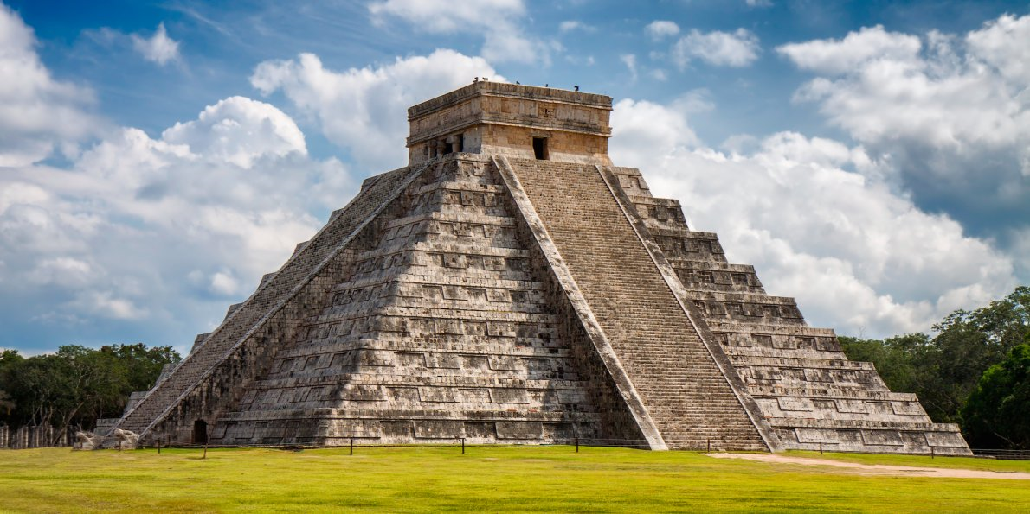
Year 4 Autumn 1 In Mexico Curriculum Driver: History

Slide 2
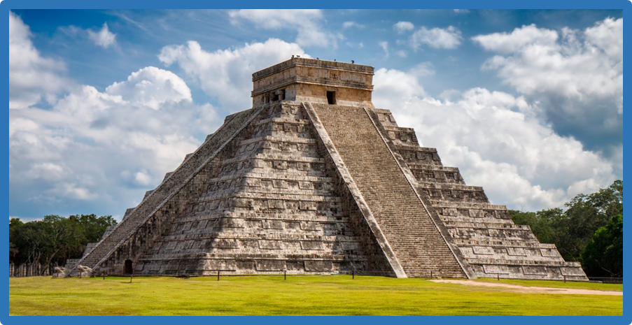
Year 4 Autumn 1 – In Mexico Key Curriculum Driver: History Other Curriculum Areas: Geography and R.E. Rationale: In Mexico will provide the opportunity for children to explore the life of the Mayan civilisation including their beliefs, daily life and trade. In addition, children will also be able to discover the origins of volcano and in particular El Chichón as one theory is that a huge volcanic ash cloud wiped out the Mayan civilisation. By the end of this topic, most children will have: • An excellent knowledge and understanding of people, events, and contexts from a range of historical periods and of historical concepts and processes. • The ability to think critically about history and communicate ideas very confidently in styles appropriate to a range of audiences. • The ability to consistently support, evaluate and challenge their own and others’ views using detailed, appropriate and accurate historical evidence derived from a range of sources. • The ability to think, reflect, debate, discuss and evaluate the past, formulating and refining questions and lines of enquiry. • A passion for history and an enthusiastic engagement in learning, which develops their sense of curiosity about the past and their understanding of how and why people interpret the past in different ways. • A respect for historical evidence and the ability to make robust and critical use of it to support their explanations and judgments. • A desire to embrace challenging activities, including opportunities to undertake high-quality research across a range of history topics. Children’s knowledge will be shown by: Extended Writing: Persuasive texts linked to cultures, persuading someone to avoid seuthsayers. Myths and Sagas Warning Tales linked to myths and legends from the Mayans. Purposeful Outcome – To create a blog/website showing our experiences throughout the topic.

Slide 3
Year 4 Autumn 1 – In Mexico
Subject | Objective
History | • Use evidence to ask questions and find answers to questions about the past. • Suggest suitable sources of evidence for historical enquiries. • Use more than one source of evidence for historical enquiry in order to gain a more accurate understanding of history. • Describe different accounts of a historical event, explaining some of the reasons why the accounts may differ. • Suggest causes and consequences of some of the main events and changes in history. • Compare some of the times studied with those of other areas of interest around the world. • Describe the characteristic features of the past, including ideas, beliefs, attitudes and experiences of men, women and children.
Geography | • Explain own views about locations, giving reasons. • Use a range of resources to identify the key physical and human features of a location. Name and locate the Equator, Northern Hemisphere, Southern Hemisphere, the Tropics of Cancer and Capricorn, date time zones. Describe some of the characteristics of these geographical areas. Describe geographical similarities and differences between countries. • Describe key aspects of: • physical geography, including: rivers, mountains, volcanoes and earthquakes and the water cycle. • human geography, including: settlements and land use.
DT | Measure ingredients to the nearest gram accurately, follow a recipe and cook ingredients.

Slide 4
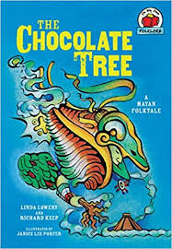
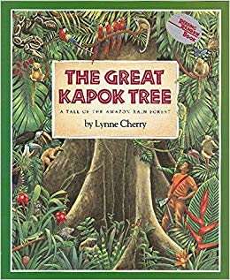
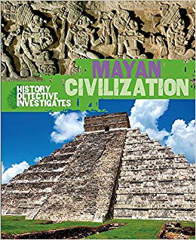
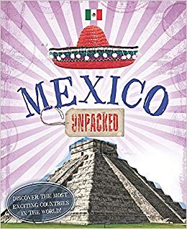
Topic Overview
Topic Hook
Mayan feast (Mayan hot chocolate, Maize tortilla, avocado, honey, sweet potato).
Children will make own hot chocolate/tortilla.
Title: In Mexico
Curriculum Driver: History
Topic Outcome
Modern day Mexico celebration, comparing to ancient mexico
Celebration Día de Muertos. Making sugar skulls.
Coverage (Main Focus)
List activities
HOOK (DT and Art) (photograph) – cooking, mask making, rune writing, hot chocolate.
Artefacts and pictures for clues out on tables for the topic. Get children to come up with questions for working wall and think alouds for what they have seen and what they think.
2. Who were the mayans? When did the Mayans live? Where did the Mayans live? (find on a map- Annotating findings on to map-research lesson
3. Then using an atlas and information texts identifying geographical features – rivers, mountains. Why might this have been a dangerous place to settle? – children then write as Mayan’s why they chose to settle in this place and annotate on maps. Debate?
4. How was ancient Mexico different or similar to Leeds?
5. Research carousel – city, work/trade, family life, education? Children choose how they want to respond – free write.
6. Religion day – Gods, beliefs and writing a creation myth. Why were the temples built in pyramids? If they were to have their own religion what would their beliefs/teachings be?
7.Why did the Mayan civilisation end? Persuasive debate in teams about different theories then writing a persuasive letter to book publisher.
6. Purposeful outcome. – day of the dead celebration. Comparing to modern Mexico.
Free Writing Stimulus
Mayan artefacts, photographs, and children’s own research.
Extended Writing Genres and Activities
Myth related to Mayan religious beliefs
Persuasive letter to persuade someone why their theory how the Mayan’s ended is the true one!
Trips and Experiences
Experience mock celebrations and cooking opportunities.
Other subject Coverage
List activities
Cooking – Following a recipe, measuring ingredients and cooking to make tortilla’s and old cocoa hot chocolate.
Geography – atlas skills, land use, settlements, rivers, mountains, cities, comparing to UK.
Art – Mask making for day of the dead and ancient mayan masks,.
Linked Texts

