Slide 1
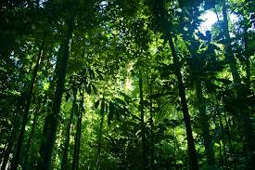
Year 5 Spring 2 In the Rainforest Curriculum Driver: Geography

Slide 2
Year 5 Spring 2 – In the Rainforest Key Curriculum Driver: Geography Other Curriculum Areas: Science and Art Rationale: In the Rainforest will provide the opportunity for children to discover the wonders of the Amazon Rainforest, studying its climate, features and the effects of humans on this amazing habitat. By the end of this topic, most children will have: An excellent knowledge of where places are and what they are like. An excellent understanding of the ways in which places are interdependent and interconnected and how much human and physical environments are interrelated. An extensive base of geographical knowledge and vocabulary. Fluency in complex, geographical enquiry and the ability to apply questioning skills and use effective analytical and presentational techniques. The ability to reach clear conclusions and develop a reasoned argument to explain findings. Significant levels of originality, imagination or creativity as shown in interpretations and representations of the subject matter. Highly developed and frequently utilised fieldwork and other geographical skills and techniques. A passion for and commitment to the subject, and a real sense of curiosity to find out about the world and the people who live there. The ability to express well-balanced opinions, rooted in very good knowledge and understanding about current and contemporary issues in society and the environment. Children’s knowledge will be shown by: Letters written to local government Artwork An assembly to showcase our learning to parents Extended Writing: Information texts letters to government Purposeful Outcome – Assembly to showcase learning to parents

Slide 3
Year 5 Spring 2– In the Rainforest
Subject | Objective
Geography | • Collect and analyse statistics and other information in order to draw clear conclusions about locations. • Identify and describe how the physical features affect the human activity within a location. • Use a range of geographical resources to give detailed descriptions and opinions of the characteristic features of a location. • Name and locate some of the countries and cities of the world and their identifying human and physical characteristics, including hills, mountains, rivers, key topographical features and land-use patterns; and understand how some of these aspects have changed over time. • Identify and describe the geographical significance of latitude, longitude, Equator, Northern Hemisphere, Southern Hemisphere, the Tropics of Cancer and Capricorn, Arctic and Antarctic Circle, and time zones (including day and night). • Understand some of the reasons for geographical similarities and differences between countries. • Describe how locations around the world are changing and explain some of the reasons for change. • Describe geographical diversity across the world. • Describe how countries and geographical regions are interconnected and interdependent. • Describe and understand key aspects of: • physical geography, including: climate zones, biomes and vegetation belts • human geography, including: settlements, land use, economic activity including trade links, and the distribution of natural resources including energy, food, minerals, and water supplies. • Use the eight points of a compass, four-figure grid references, symbols and a key (that uses standard Ordnance Survey symbols) to communicate knowledge of the United Kingdom and the world.

Slide 4
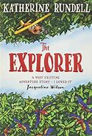
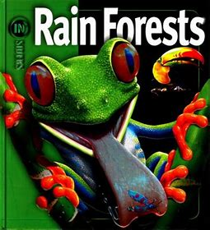
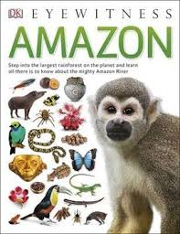
Topic Overview
Topic Hook
Title: In the Rainforest
Curriculum Driver: Geography
Topic Outcome
Coverage (Main Focus)
Hook lesson- art creating 3d macaws using tissue paper to create effect of feathers.
Layers of the rainforest – what does this mean? How does this affect ujs?
Where does our food come from? How do we rely on the rainforest? – looking at information sheets to gather information, class discussion, chrome books for further research. Taste testing foods from the rainforest.
Free write session linked to WBD.
Palm oil – what is it? How does it effect us? The rainforest. Choildren complete answers to key questions using skills from reading lessons. Ch use chromebooks for further research. (Which sources of information are better and why?
Map work – Locate the Amazon on a map. What is it’s climate? Why is it like that?
Write a persuasive letter persuading Boris Johnson to act on palm oil/deforestation (direct based on children’s interests/feedback from English writing units.
How is the amazon changing? Why? - Deforestation
Free Writing Stimulus
Free write- World book Day link to our class novel ‘ The Explorer’
Extended Writing Genres and Activities
Extended writing- letter campaigning for protected areas to Boris Johnson.
Trips and Experiences
.
Food tasting
Animal visitor looking and handling rainforest creatures.
Other subject Coverage
List activities
Science– Animals, plants , adapatation and inheritance links.
Art – Animal (Macaw) art using different medium to look like feathers. Mosaic effect.
Linked Texts

